Slide 1
Valuing Powertrain, Range and Age in the used vehicle market
Zain Hoda (zain.hoda@gwu.edu) ¹
Xiatian Iogansen (xiatian.iogansen@nist.gov) ^{1,2}
Christina Gore (christina.gore@nist.gov) ²
Joshua D. Kneifel (joshua.kneifel@nist.gov) ²
John Paul Helveston, Ph.D. (jph@gwu.edu) ¹
1: George Washington University
2: National Institute of Standards and Technology
Notes:
Hello, today we are going to talk about our work where we are studied user preferences in the use vehicle market.

Slide 2
Why the used vehicle market?
Volume: Used vehicles are 70% of all US vehicle transactions [1]
Limited prior research on preferences for alternative powertrains in the used market
Used market for HEVs and BEVs is rapidly growing
Used HEV and BEV buyers have different concerns compared to used ICEV buyers
References:
[1]
[2]

Slide 3
Research Questions:
How does consumer willingness-to-pay for used vehicles attributes compare across vehicle types and budgets?
How do alternative powertrain vehicles compete against their conventional counterparts in the current used market?

Slide 4
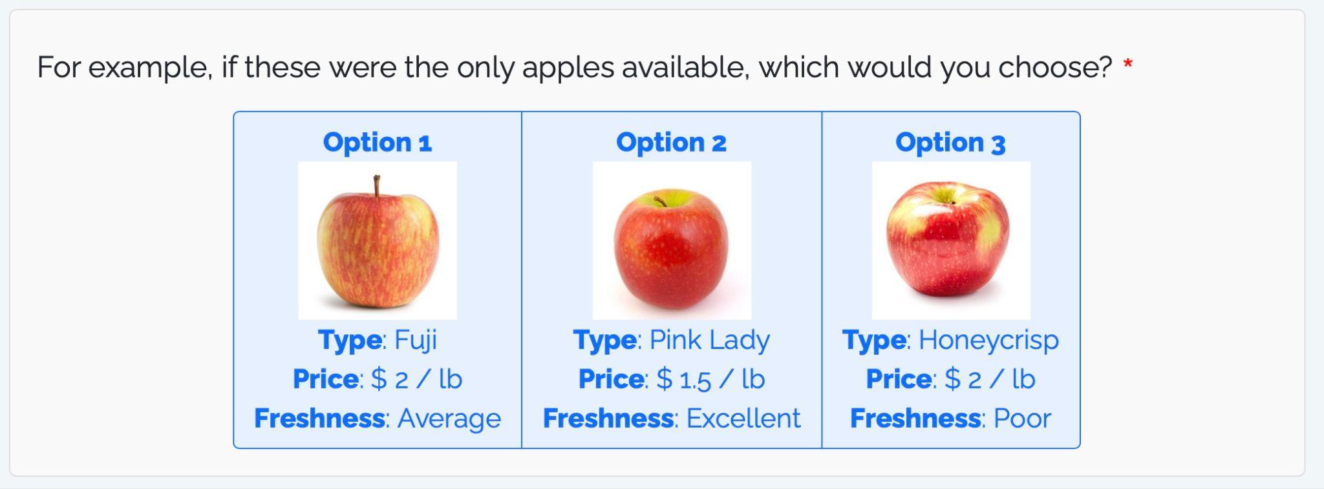
Method - What is Conjoint?
Provide respondents with different sets of attributes.
Observe choices across random sets.
Estimate utility of each attribute.
Notes:
Conjoint analysis is a survey-based market research method that measures how much value customers place on different features of a product or service. By asking participants to choose between various product combinations, it reveals the exact trade-offs they are willing to make

Slide 5
Survey Sample Strategy
Data collected online between December 2025 and April 2026 via two panel providers (Dynata and Prolific)
Records after initial preprocessing were 3,657 but final sample was reduced to 2,254 based on screening checks
Segment
Low budget CAR (≤20k)
High budget CAR (>20k)
Low budget SUV (≤25k)
High budget SUV (>25k)
Respondents segmented by vehicle choice and budget range

Slide 6
Conjoint attributes
Segment | Price | BEV Range | Powertrain | Model Year | Mileage (miles) | Operating Cost (cents/mile)
Low budget CAR (≤20k) | $10k - $20k | 50-150 mi | Conventional Gas Hybrid BEV | 2015 - 2023 (2-year increments) | 20,000 - 60,000 (5000-mile increment) | ICEV: 9-18 HEV: 6-12 BEV: 3-12
High budget CAR (>20k) | $20k - $40k | 100-250 mi
Low budget SUV (≤25k) | $15k - $25k | 150-250 mi |  |  |  | ICEV: 9-18 HEV: 9-18 BEV: 3-12
High budget SUV (>25k) | $25k - $45k | 200-350 mi

Slide 7
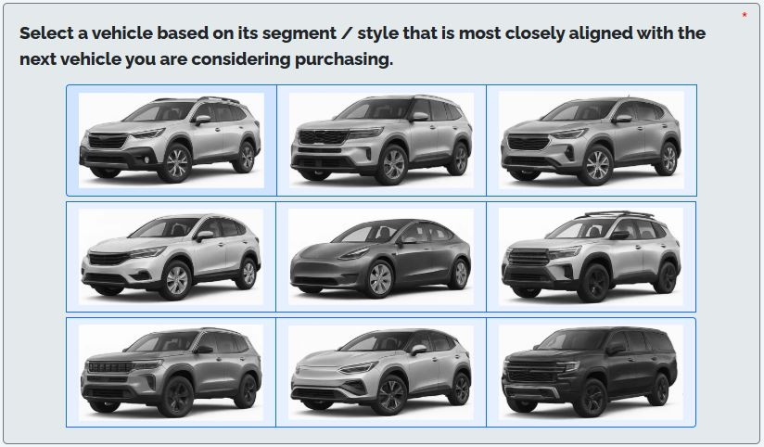
Vehicle selection

Slide 8
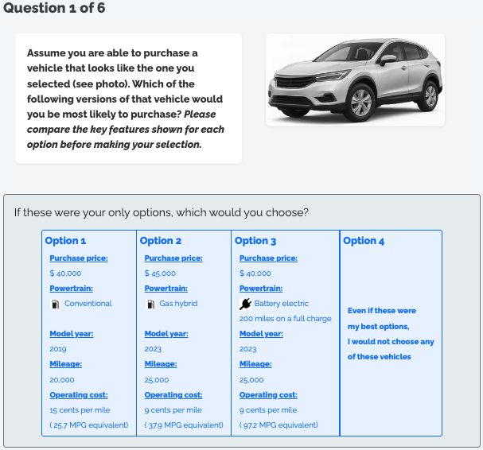
Example choice question

Slide 9
Example choice question

Slide 10
How do consumer willingness-to-pay estimates for used vehicle attributes compare across vehicle types and budgets?

Slide 11
Modeling:
6 mixed logit models were estimated in the ‘Willingness-to-pay’ space, separated by:
  Vehicle segment (Car vs. SUV)
  Budget Tier (Low vs. High)
Models estimated using the logitr R package (6 repeated choice per respondent, 5000 sobol draws, 10 multi-starts per model).
Notes:
5,000 draws: "Mixed logit has no exact likelihood, so we approximate it by averaging choice probabilities over 5,000 Sobol draws of each respondent's preferences. Sobol draws cover the space evenly, so the estimates are accurate and stable."
10 multi-starts: "The likelihood can have multiple peaks, so we start each model from 10 random points and keep the best result. This makes it likely we found the true maximum, not a local one."

Slide 12
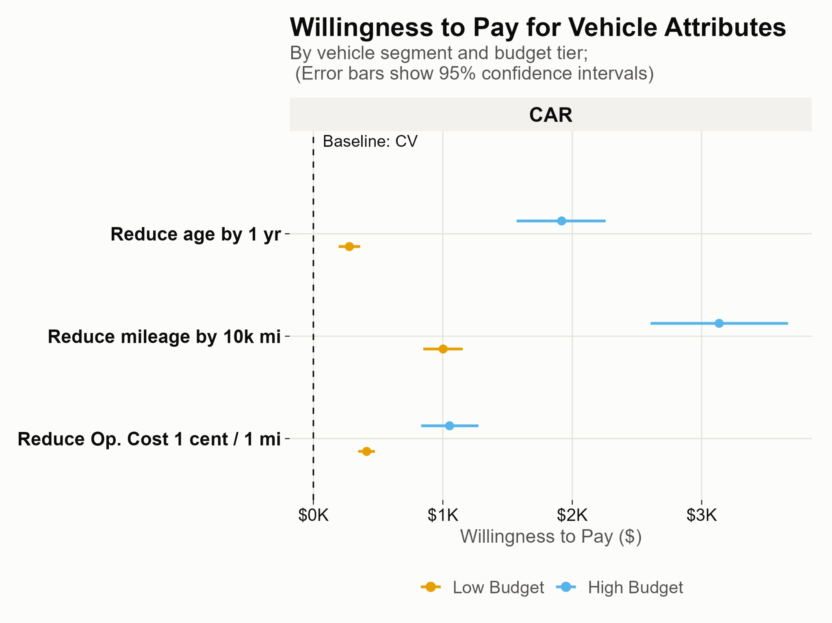
Willingness to pay for vehicle attributes
Notes:
I am showing you what % of listings were electric in the new market within the 40-50 thousand price segment.
You can see that in recent years we’ve seen pretty fast growth @
I’ll also note that the circle in the top-left shows the overall market size for all vehicles. In this segment, it is about 1.7 million vehicles

Slide 13
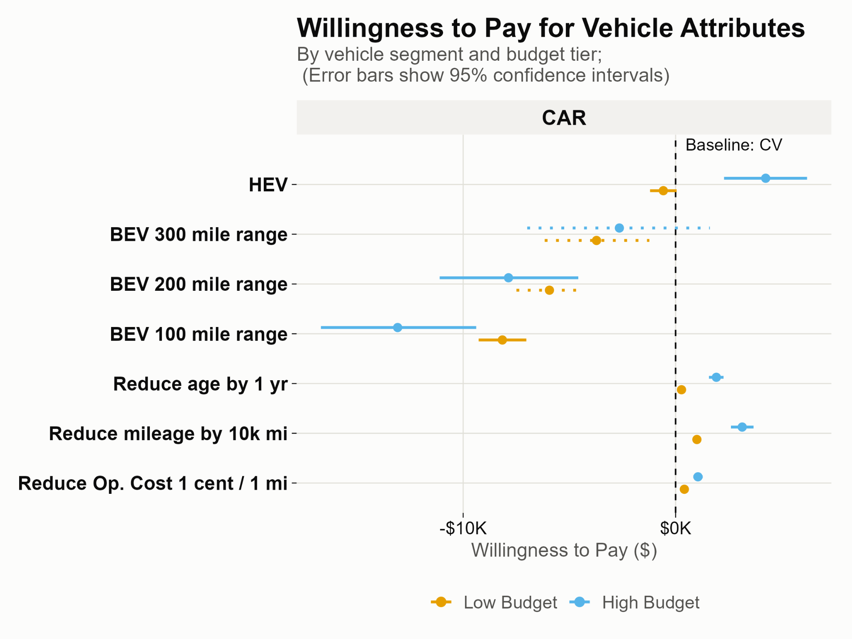
Willingness to pay for vehicle attributes

Slide 14
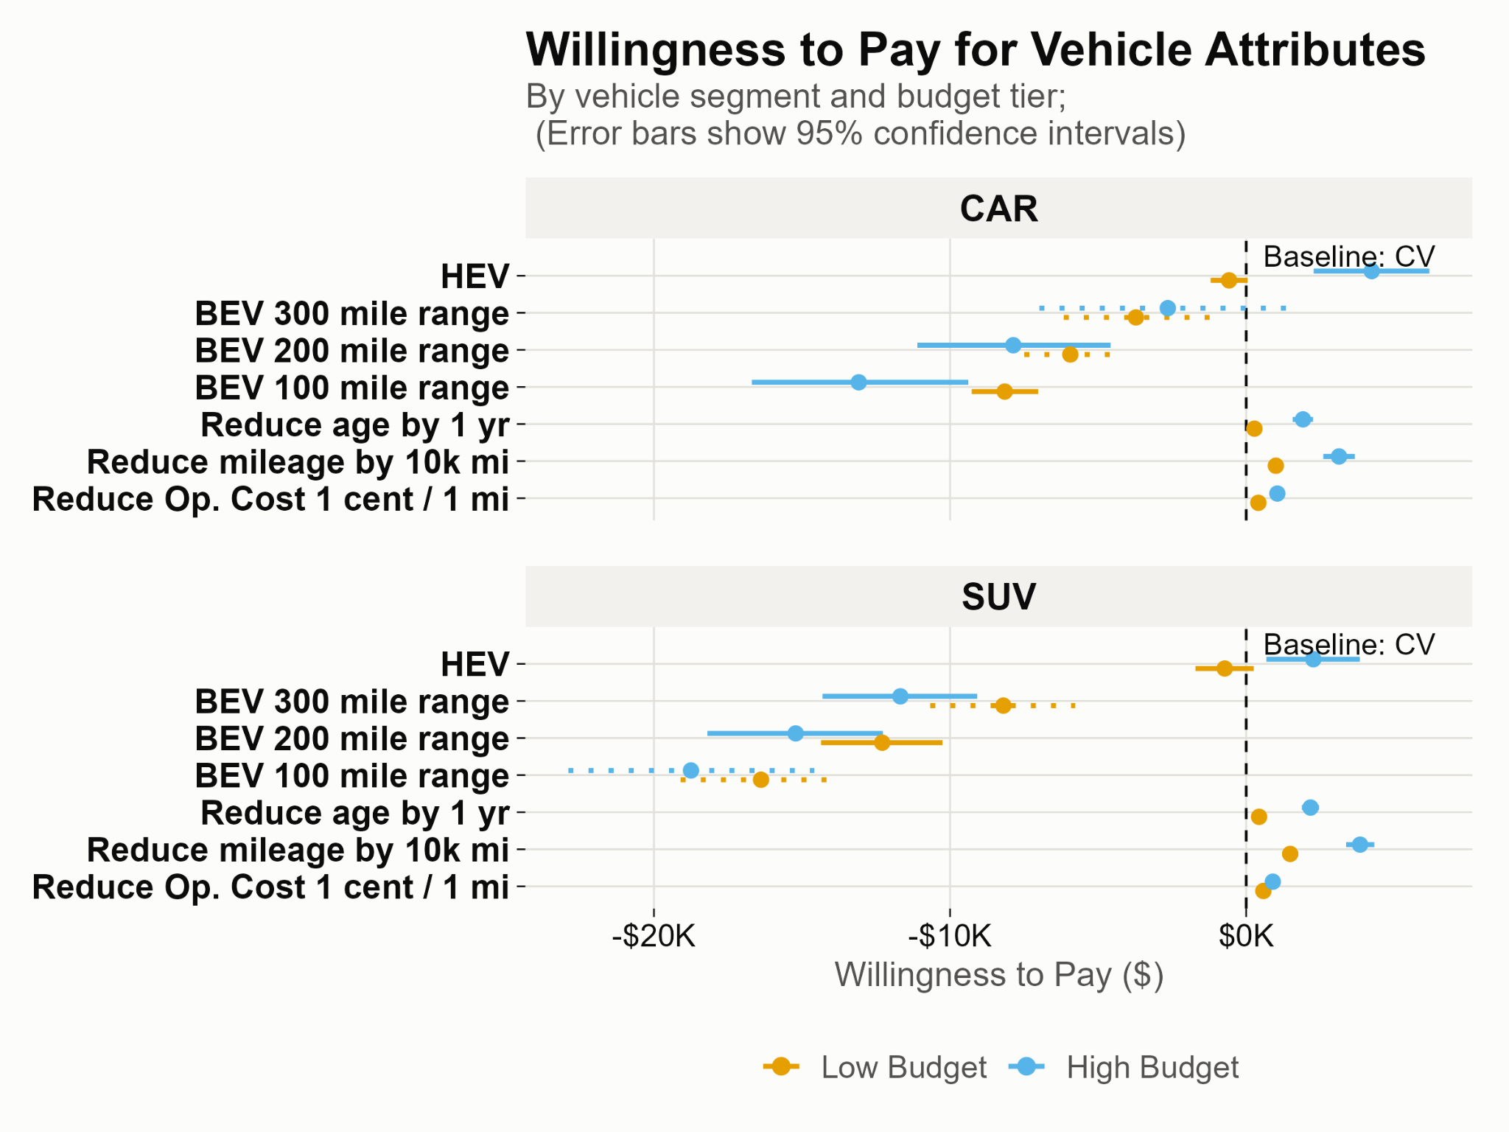
Willingness to pay for vehicle attributes

Slide 15
How do existing non-CVs compete against their CV counterparts in the real market?
Notes:
That led us to another question, which is “At what driving range does a BEV reach total cost of ownership parity with a comparable ICEV?”
Before answering that, we first converted the listing prices to monthly payments.

Slide 16
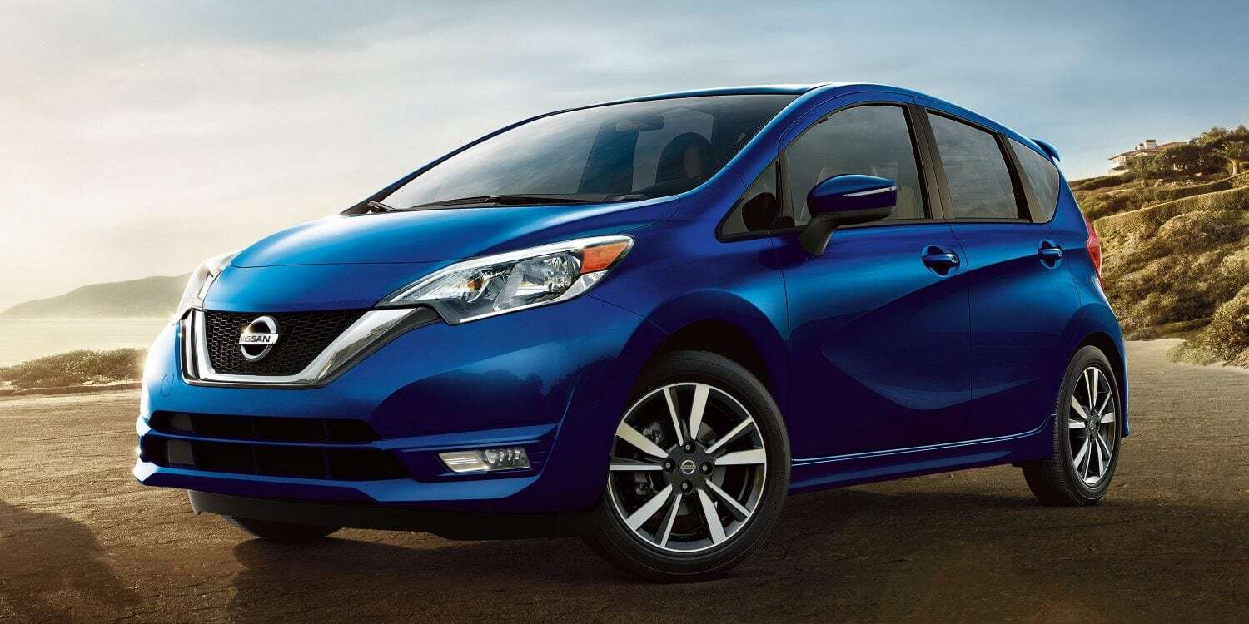
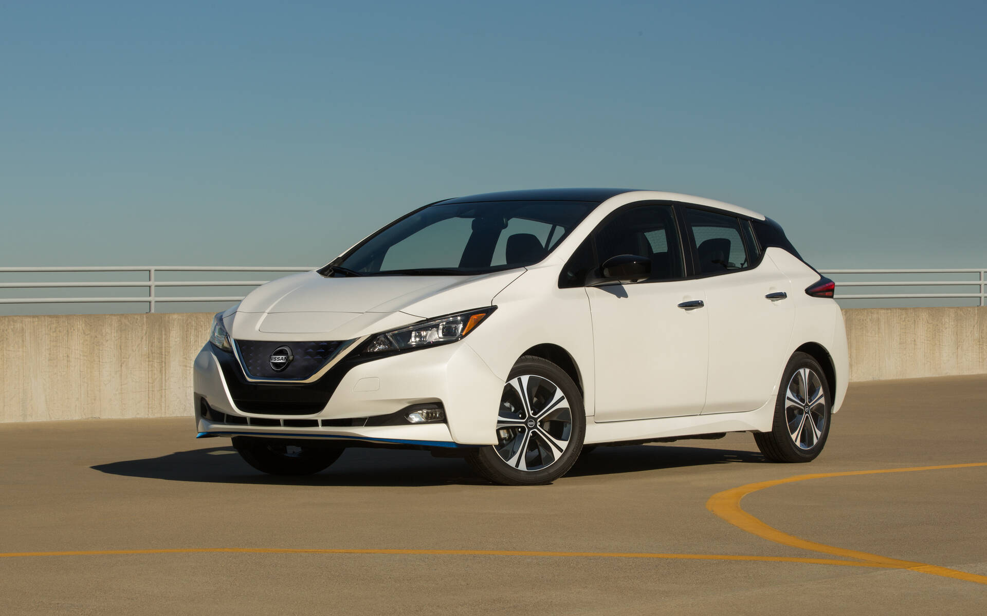
Nissan Versa Note vs. Nissan Leaf (3 years old)
CV image
CV image
Nissan Versa
Mean price: $14,046
Op. Cost: 13.8 cents/mile
Count: 7,192
Nissan Leaf
Mean price: $22,630
Op. Cost: 4.7 cents/mile
Count: 8,922
Note:
Data source is Marketcheck.com and all the vehicles are between 2.5 to 3.5 years old used vehicles.
Budget ranges were increased by 20% to get comparable ICEV and BEV vehicles.

Slide 17
Vehicles compared against CV counterpart
Budget | Vehicle Type | AFV Powertrain | AFV vehicle count
Low | CAR | BEV | 8,922
Low | SUV | BEV | 1,658
High | CAR | BEV | 378
High | CAR | HEV | 4,366
High | SUV | HEV | 16,989
Note:
Data source is Marketcheck.com and all the vehicles are between 2.5 to 3.5 years old used vehicles.
Budget ranges were increased by 20% to get comparable ICEV and BEV vehicles.
Notes:
We wanted to bring this to everyone’s attention that is not the case that BEV vehicles are just not there, but the majority of these vehicles are out of people’s budgets.

Slide 18
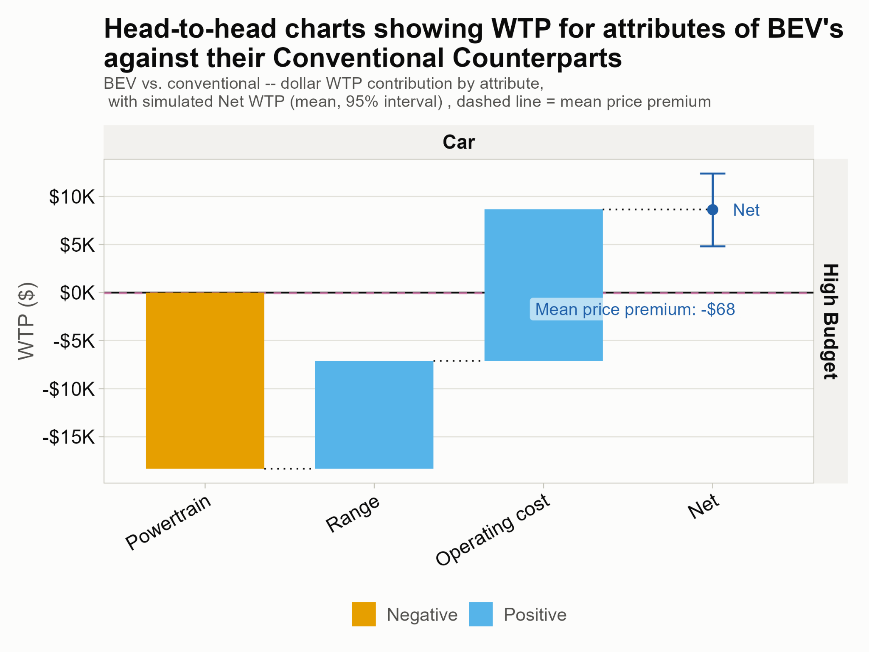
Notes:
We wanted to bring this to everyone’s attention that is not the case that BEV vehicles are just not there, but the majority of these vehicles are out of people’s budgets.

Slide 19
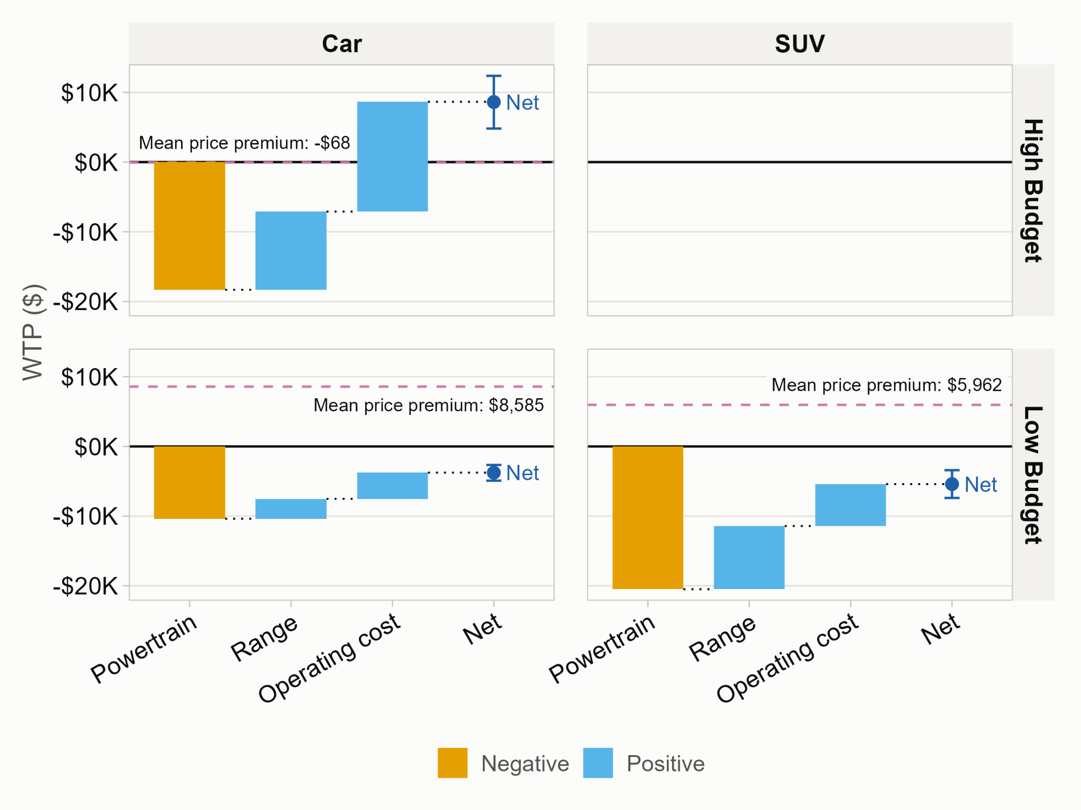
Notes:
We wanted to bring this to everyone’s attention that is not the case that BEV vehicles are just not there, but the majority of these vehicles are out of people’s budgets.

Slide 20
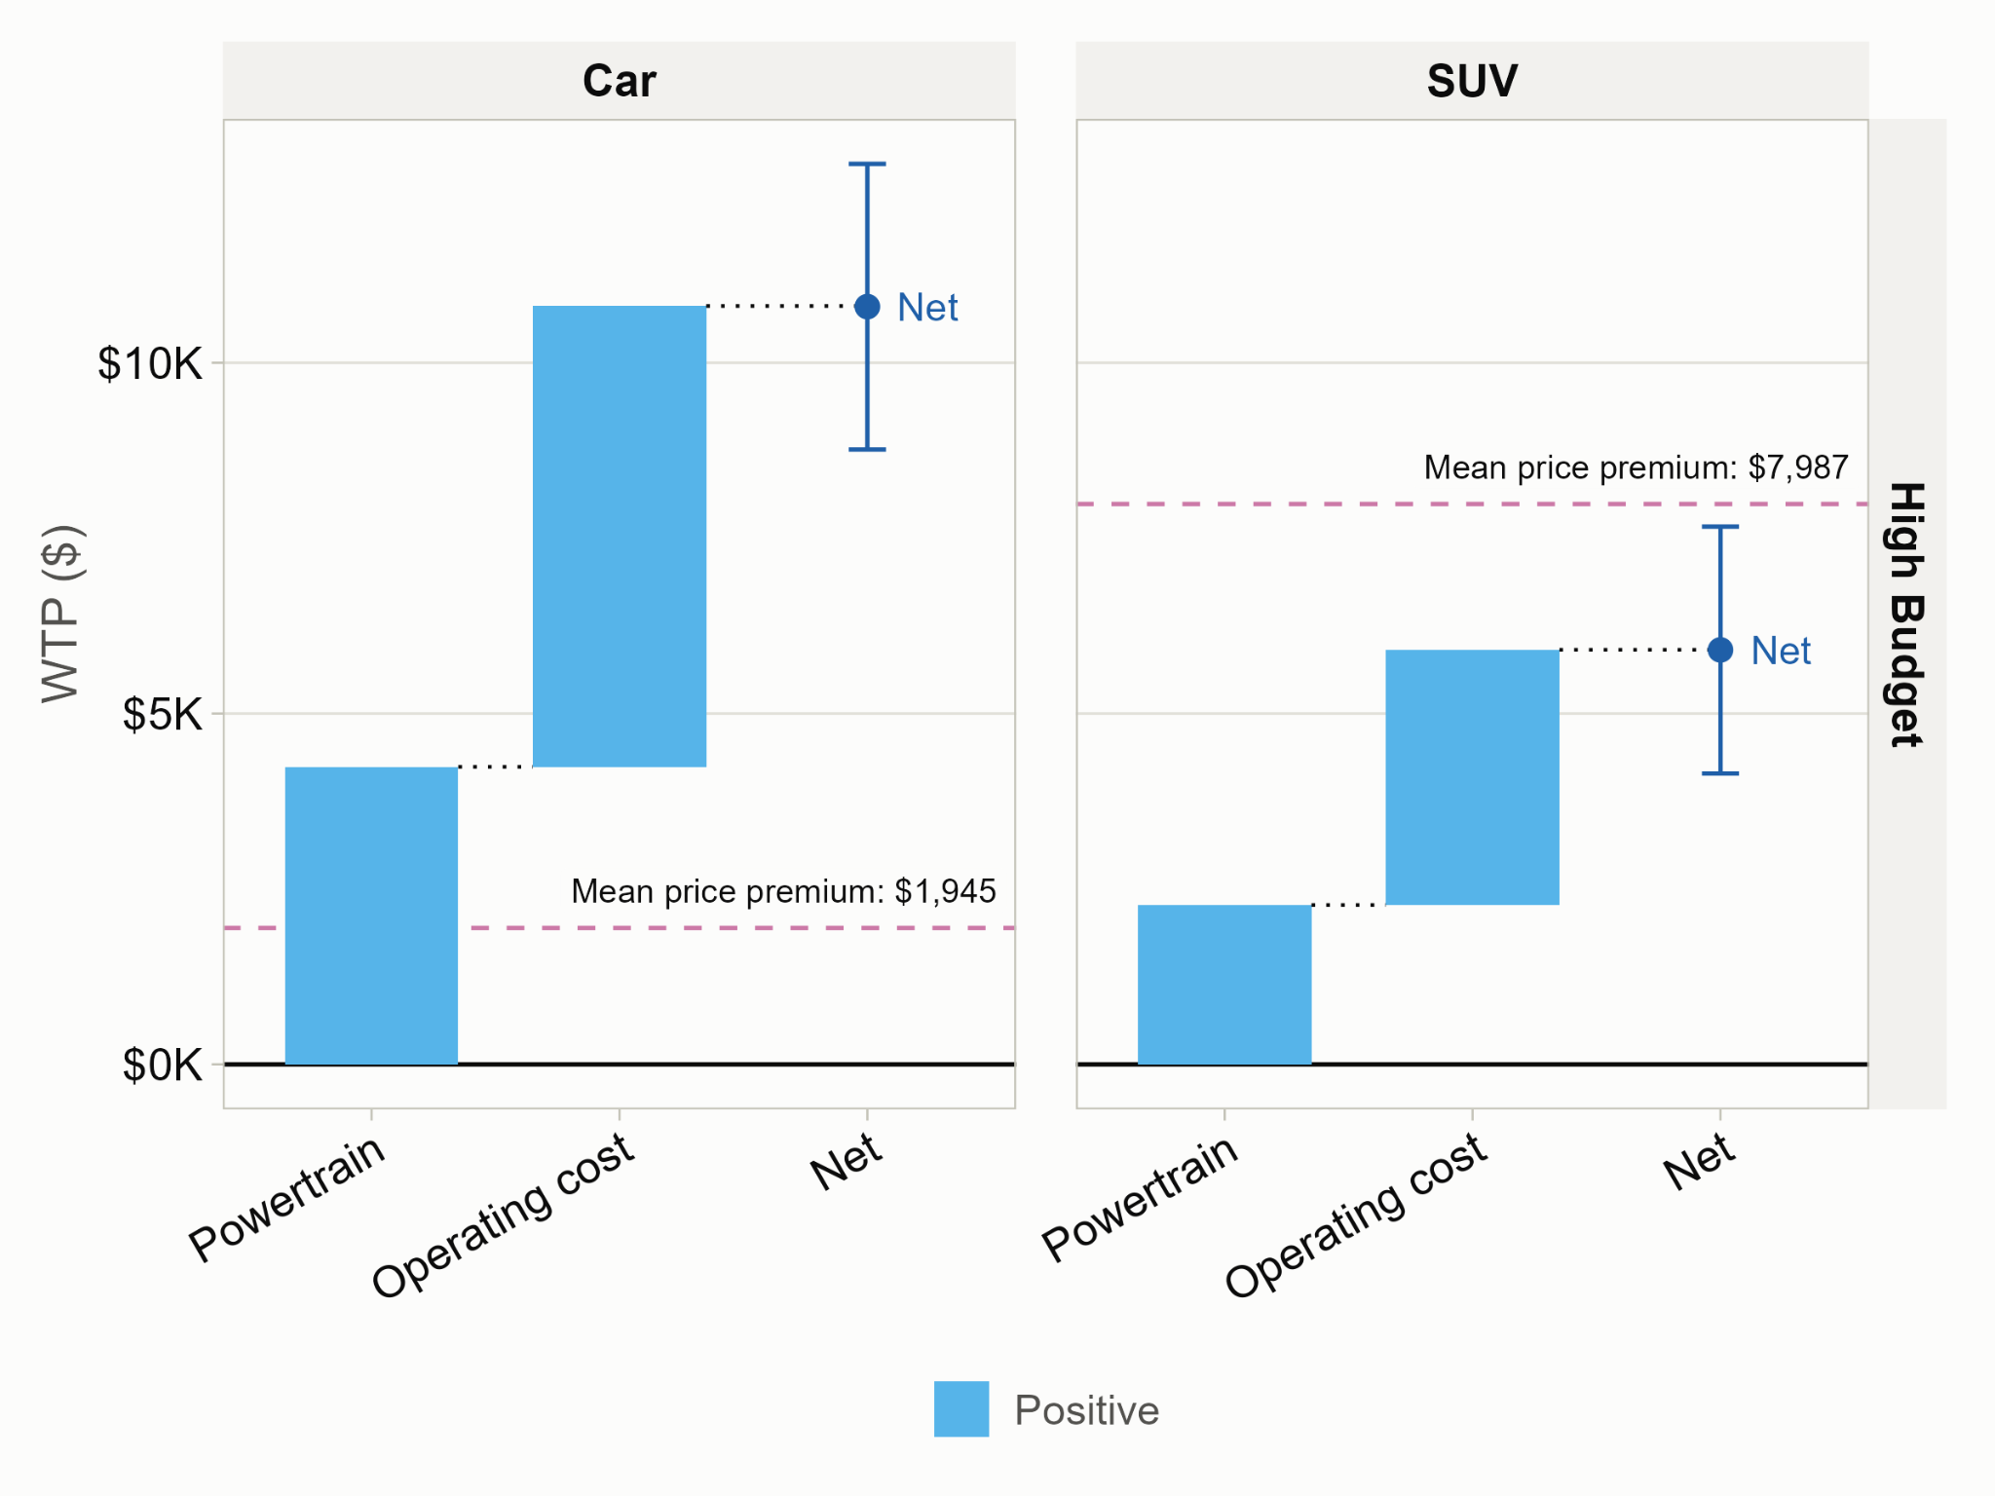
Notes:
We wanted to bring this to everyone’s attention that is not the case that BEV vehicles are just not there, but the majority of these vehicles are out of people’s budgets.

Slide 21
Policy Implications:
Results justify the (former) federal used clean-vehicle credit (up to $4,000) to close the WTP gap for used BEV buyers.
The 25,000 price cap is too stringent and excludes many of the higher-range used BEVs, which are much closer to competitive with CV counterparts.
Notes:
It's a fraction of the 8K–19K gap facing most other segments

Slide 22
Conclusions:
Driving range and mileage are the dominant value determinants for used BEVs.
Used BEVs reach closer to price parity with CVs in only one segment: high-budget, high-range cars
Used HEV cars are already competitive

Slide 23
Limitations:
Stated, not revealed, preferences (hypothetical bias possible)
MXL models assume continuous normal heterogeneity
Battery state-of-health was not varied in this DCE (covered in a companion battery-attribute DCE)

Slide 24
Extra

Slide 25
Model table from paper
Notes:
We wanted to bring this to everyone’s attention that is not the case that BEV vehicles are just not there, but the majority of these vehicles are out of people’s budgets.

Slide 26
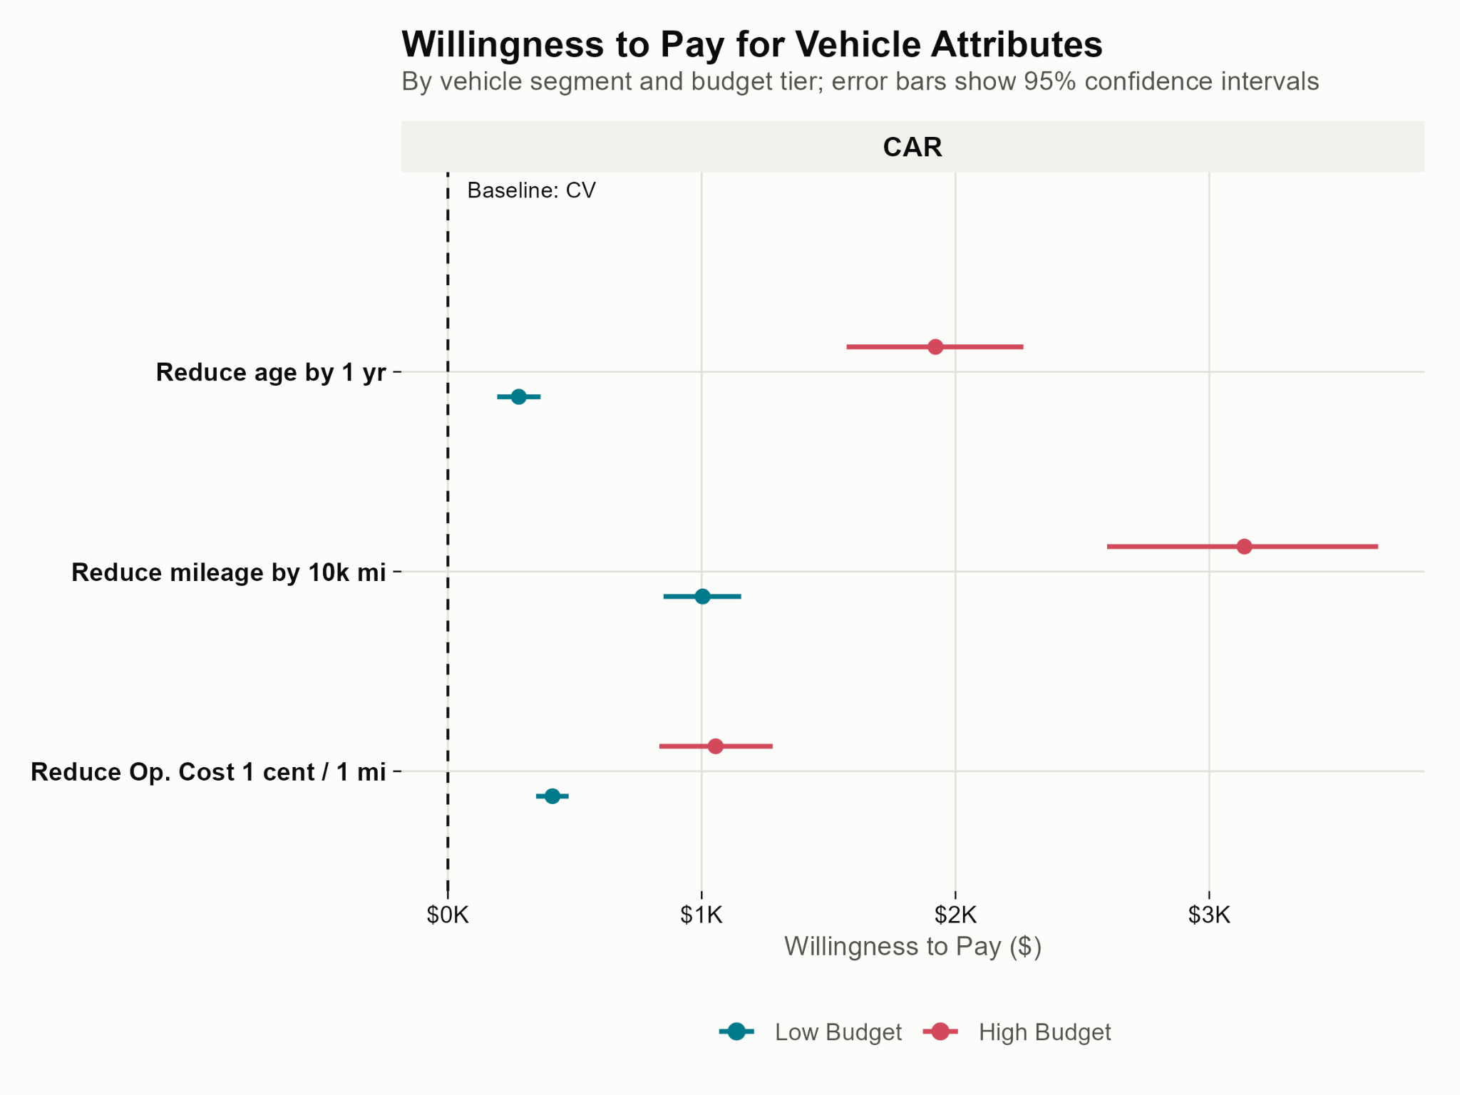
Willingness to pay for vehicle attributes
Notes:
I am showing you what % of listings were electric in the new market within the 40-50 thousand price segment.
You can see that in recent years we’ve seen pretty fast growth @
I’ll also note that the circle in the top-left shows the overall market size for all vehicles. In this segment, it is about 1.7 million vehicles

Slide 27
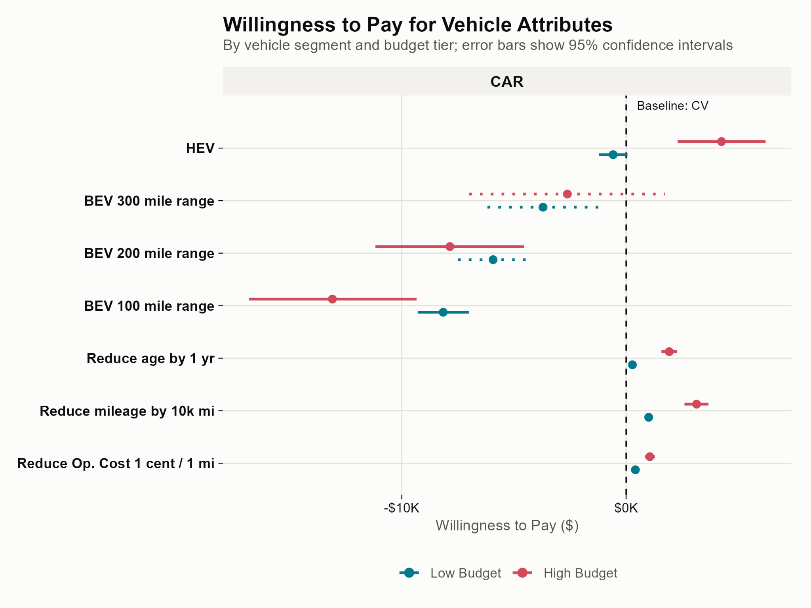
Willingness to pay for vehicle attributes

Slide 28
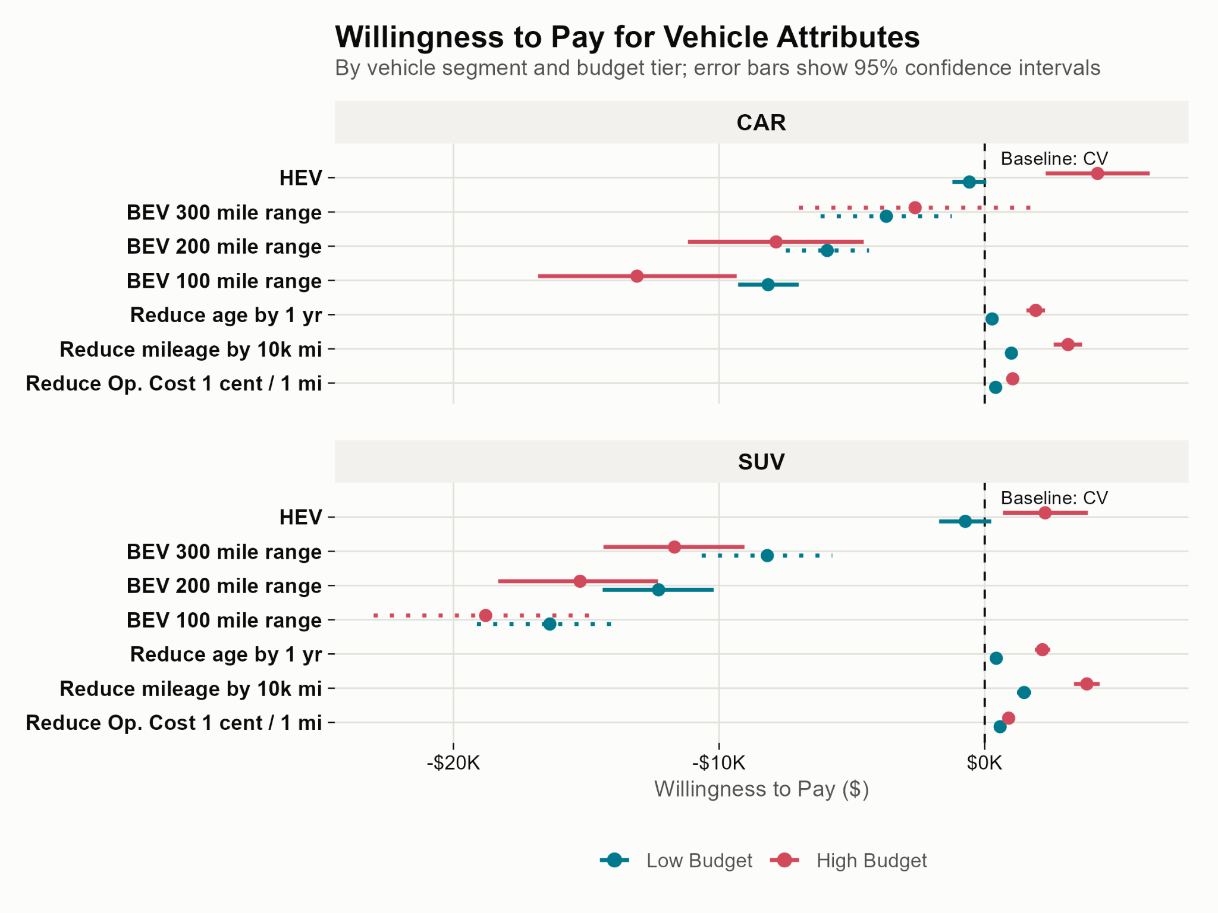
Willingness to pay for vehicle attributes

Slide 29
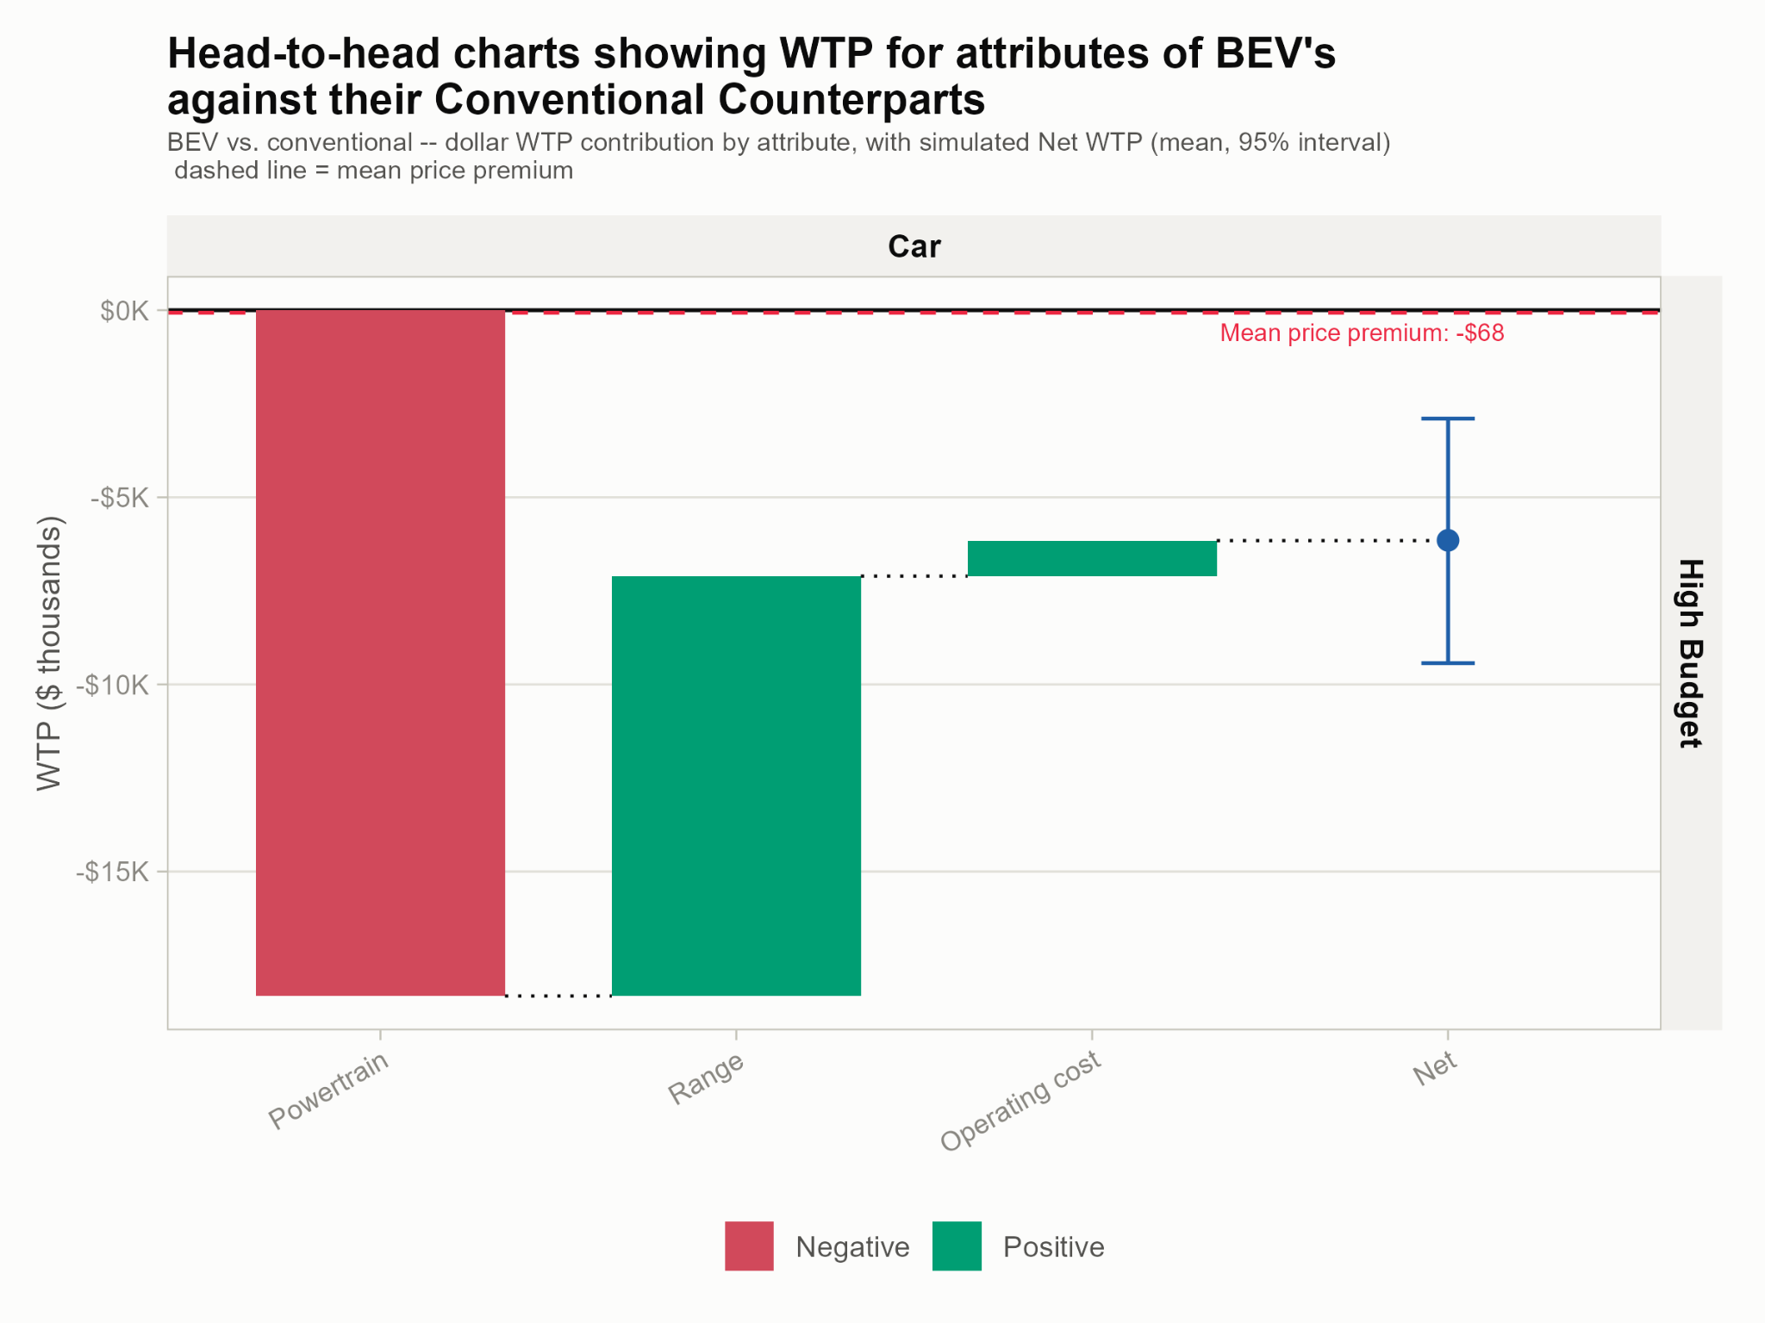
Notes:
We wanted to bring this to everyone’s attention that is not the case that BEV vehicles are just not there, but the majority of these vehicles are out of people’s budgets.

